Slide 1

Hyper Evolve Logic Programmers
Presents
GYNOGUIDE
MAIT 4.0 Hackathon
“Your Gynecological Compass for Wellness.”

Slide 2

ABOUT US
GynoGuide is a comprehensive women's health platform offering AI-driven assistance for gynecological queries, online doctor consultations, and curated blogs on PCOD, PCOS, hygiene, and women's cancer. Bridging healthcare gaps, it fosters a supportive community. With personalized health journals and a resource library, GynoGuide ensures every woman has the tools for informed decisions and holistic well-being.
Welcome to a space where empowerment meets guidance for a healthier you.

Slide 3


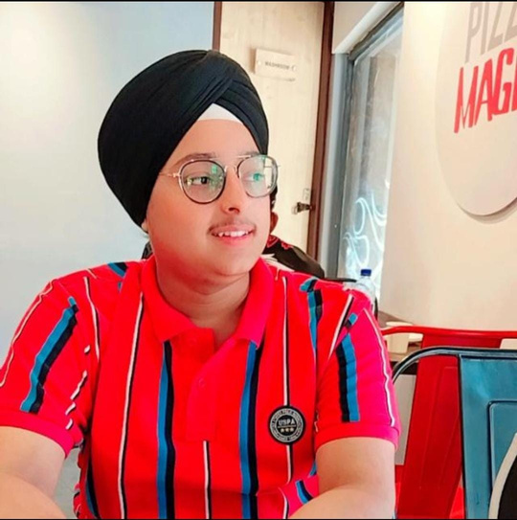
MEET OUR TEAM
Gurneesh Kaur
Aryan Bains
Sehajjyot Singh
Team Leader
(Frontend developer)
Backend and AI Developer
Web Dev

Slide 4



FACETIME CONSULTATIONS
Facetime consultations provide immediate, personalized healthcare from anywhere. This privilege ensures convenient access to expert advice, saving time and enhancing overall well-being in just a few clicks.
AI CHATBOT
BLOGS AND MAGAZINES
The chatbot is programmed with a vast database of information and can offer immediate guidance on common concerns, such as menstrual health, birth control, and sexual health.
Blogs and magazines offer the privilege of diverse, accessible knowledge. They empower readers with insights, tips, and expert advice, fostering continuous learning and informed decision-making across various topics and interests.

Slide 5






Patient records, prescriptions, and pertinent data stored in one location, streamlining accessibility for authorized users.
Accessibility across different devices, allowing doctors to make informed decisions regardless of their location.
Electronic Health Records
A secure platform for doctors to update prescriptions, share test results, and discuss patient care plans.
Informed patients can actively participate in their healthcare decisions, fostering a collaborative approach.

Slide 6
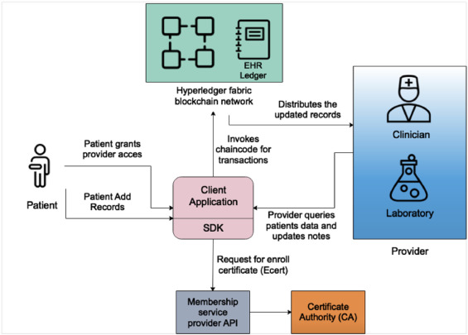
Blockchain Implementation
Enhanced Security:
Smart contracts automate and enforce data-sharing agreements, providing efficient and secure EHR access control.
Interoperability Improvement:
Integration of interoperability protocols facilitates seamless communication between different healthcare systems, promoting a unified approach to patient data.
Privacy Measures:
Encryption mechanisms enhance the privacy of patient information, mitigating the risk of data breaches.
Patient-Centric Identity Management:
Decentralized identity management empowers patients with greater control over their health data through cryptographic keys.

Slide 7

PERCENTAGE OF HEALTH CARE NEEDS
There about 5.82cr women in India. Around 50% of women, i.e 29.1cr feel shame of accessing basic healthcare facilities. If we will be able to provide our facilities even to 1% of women, i.e, 29.1lakh, it will be a great success for our platform.

Slide 8

THANK YOU

